Slide 1
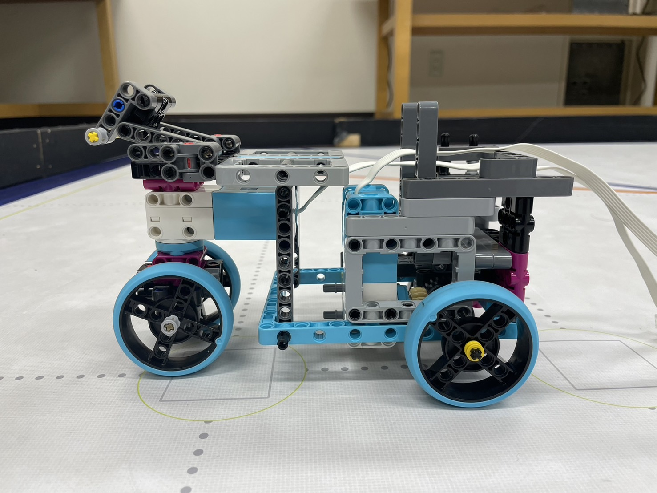
Chassis design / selection
Camera mount
SPIKE Prime L angular motor
Space is created at the rear of the vehicle to accommodate the mobile battery and battery box.
By creating a support with LEGO SPIKE, the parts were prevented from falling and the mounting performance was improved.
SPIKE Prime M angular motor
Space for battery

